Slide 1
Remix as Resistance and Discourse John Vallier
Rochelle Lundy and Maryam Fakouri
Jan. 22, 2017

Slide 2
Agenda
Property law generally
What copyright protects
Copyright duration
How to obtain copyright protection
Rights included in copyright
Using other people’s works: fair use and licensing

Slide 3
CAUTION!
Nothing in this presentation is legal advice.
You may leave with more questions than you had when you arrived.
You may not feel comfortable with uncertainty.
You might find copyright law to be interesting.
Notes:
Audience discretion is advised.

Slide 4
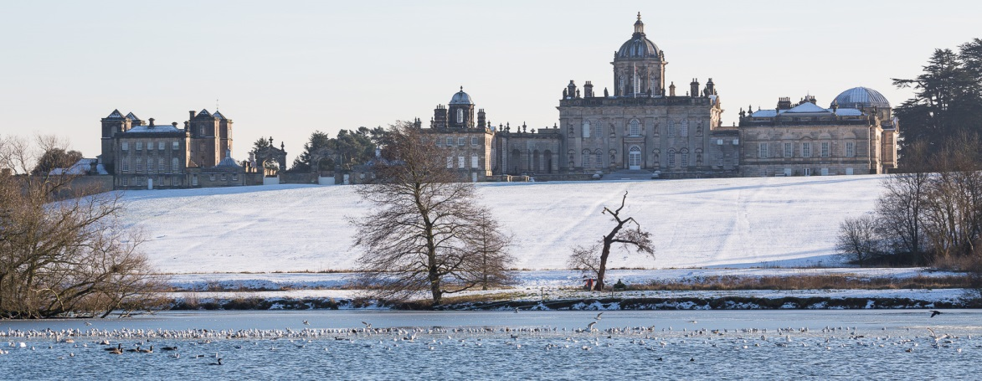
Castle Howard Lake by alh1 is licensed under CC BY NC ND.
Notes:
Land was—and still is—wealth. American property law is derived from English law. When English colonists arrived, they brought English notions of private property. English law had complex rules about who can own property, who can inherit property, who can use property, etc.
Land = Wealth

Slide 5
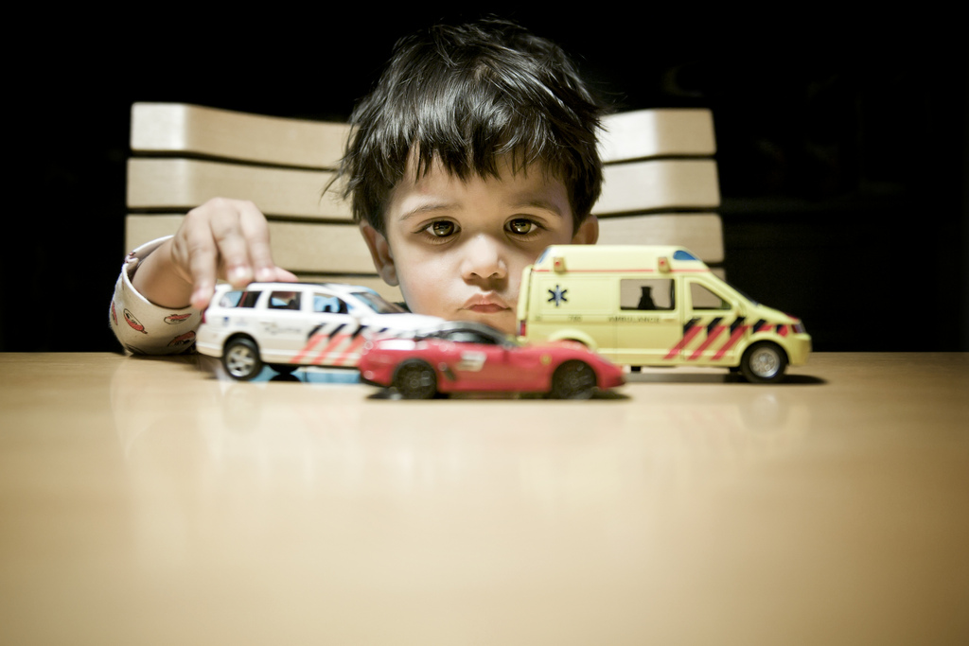
Cars by Philippe Put is licensed under CC BY NC.
Notes:
The notion of exclusive ownership of property extends from actual land to objects.
Critical notion of property ownership is that it’s exclusive. Even small children have a firm sense of ownership. Kids learn the word “mine” pretty early.

Slide 6
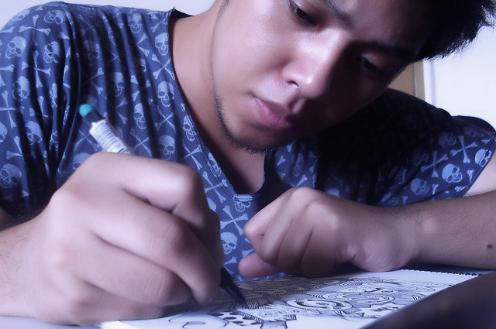
Seriously doodling LOL by Anjo Bolarda is licensed under CC BY SA.
Notes:
Eventually the notion of exclusive rights of use extended from land to objects to products of intellect.

Slide 7
Intellectual Property Protections
Copyright protects expressive works.
Trademark protects symbol used to designate the origin of a good or service used in commerce.
Patent protects processes, machines, inventions, manufacturing methods, and their improvements.
Trade secret protects information that derives value from not being known, e.g., a secret recipe.
Notes:
Copyright is one form of intellectual property.

Slide 8
What does copyright protect?
Copyright protects original works of expression with more than a “modicum of creativity” that are fixed in a tangible medium of expression. These include (17 U.S.C. §102):
literary works
musical works, including accompanying words
dramatic works, including accompanying music
pantomimes and choreographic works
pictorial, graphic, and sculptural works
motion pictures and other audiovisual works
sound recordings
architectural works
Notes:
Original
Works of expression
More than a modicum of creativity – Modicum? to come
Fixed in a tangible medium of expression

Slide 9
What is not protected by copyright?
Facts
Ideas
Discoveries
Systems and processes
Works in the public domain
Useful articles
Short titles
Works by the US federal government
Notes:
Why are these things not protected by ©? We‘ll explore in examples to come.
Fact- nobody owns
Idea – not yet fixed
Discovery – other body of law
Public domain – often works whose © has expired
Useful articles – no © because we don‘t want them to be monopolized, e.g. fork, clothing
Systems and processes – other body of law
Short titles, e.g. Modern Love(rs), Black Star (Bowie, Talib Kweli and Mos Def, Acril Lavigne and others).
Works by the fed gov‘t

Slide 10
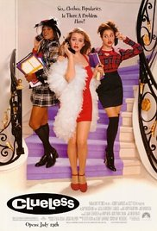
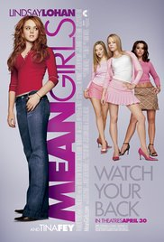
Is this protected by copyright?
B. Screenplay
A. Plot
A new student befriends popular girls at a high school.
Notes:
Mean Girls or Clueless or another movie?
Fixation. Idea / Expression dichotomy.
Why? We know what’s protected.
This plot could flower into many possible stories. “Clueless” and “Mean Girls” scripts are copyrightable expressions because they are fixed (specific), display more than a modicum of creativity.

Slide 11
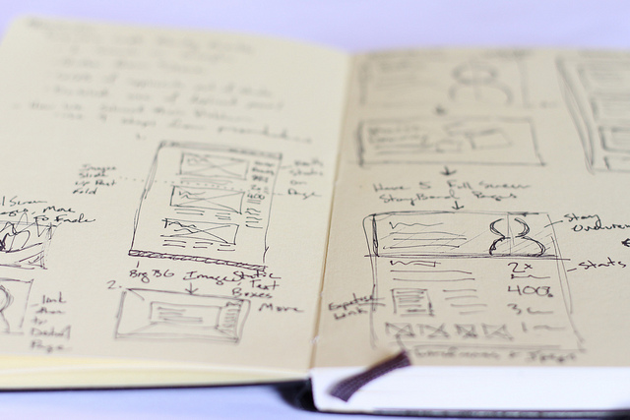
Is this protected by copyright?
A. Notes
B. Simple recipe for egg salad
Place egg in a saucepan and cover with cold water. Bring water to a boil and immediately remove from heat. Cover and let eggs stand in hot water for 10 to 12 minutes. Remove from hot water, cool, peel and chop.
Place the chopped eggs in a bowl, and stir in the mayonnaise, mustard and green onion. Season with salt, pepper and paprika. Stir and serve.
Notes by INPIVIC Family is licensed under CC BY.
Notes:
A “modicum of creativity” is pretty low.
Simple procedures are not protected. Recipes in particular are not. BUT creative expressions of recipes might be protected, e.g. lots of commentary in the recipe, drawings, photos. Smitten kitchen food blog.

Slide 12
How long does copyright last?
For works with known human authors
Life of the (last surviving) author + 70 years
For works for hire or works with anonymous authors, the shorter of
120 years after creation
95 years after publication
For works created prior to 1978, the situation can be complicated.
Notes:
Bottom line safe bet: Assume everything created after 1923 is protected.

Slide 13
How do you secure a valid ©?
Copyright protection is automatic!
Notice tells the world who owns a work and when © protection began.
© 2017 Serena Williams
• Registering a work with the US Copyright Office makes a public record of ownership and entitles owners to statutory damages ($$$) in case of infringement.
Notes:
In the past, there were more formalities to secure © protection. Now, there are NONE. But notice and registration have advantages.
Safe practice to assume works are protected even if they do not have © notice.

Slide 14

Asparagus by Pat Kight is licensed under CC BY NC ND.
What is copyright?
Copyright is a bundle of rights.
Like this bundle
of asparagus.
Notes:
In sum, © is a bundle of rights. You can manage the individual rights independently. For example, you can license the right to make a derivative work of your fiction writing.

Slide 15
A copyright owner “has the exclusive rights to do and to authorize any of the following” (17 USC §106):
• Reproduce a work
• Prepare a derivative work
• Publicly distribute a work
• Publicly display a work
• Publicly perform a work
• In the case of sound recordings, to perform the work publicly via digital audio transmission
Notes:
Single work but plural concept. We should say copyrights.
What do these rights have in common? Why would we protect these things?
They are ways to monetize creative works. Also publicize works.

Slide 16
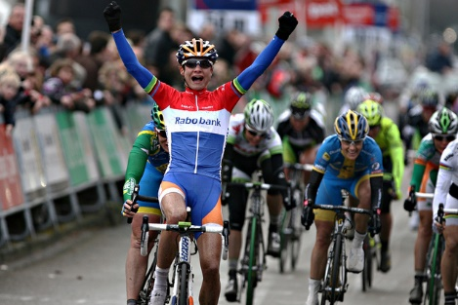
Is this a photographer’s exclusive right?
A. Publish his photograph of Marianne “the Cannibal” Vos in Sports Illustrated magazine
B. Clip the photo from Sports Illustrated and put in on his refrigerator for motivation
Marianne Vos wins over Kristen Wild and Emma Johansson by anMarton is licensed under CC BY NC ND.
Notes:
A. Exclusive right of photographer. Publications license photos from photographers
B. Probably not an EXCLUSIVE right. Use is not reproducing the image or displaying it publicly. Not a public display. Not public distribution. Image is already published. If someone else makes same use of the photo, it’s de minimus infringement if infringement at all.
ANALOG example. Digital is different because that involves copyright work.

Slide 17
Is this a photographer’s exclusive right?
A. Publish his photograph of Marianne “the Cannibal” Vos on his blog
B. Download the photo from his blog and use it as his screensaver for motivation
Marianne Vos wins over Kristen Wild and Emma Johansson by anMarton is licensed under CC BY NC ND.
Notes:
Exclusive right of photographer.
B. Technically it’s a violation of © because it involves copying the work. Even tho user is not displaying the photo publicly. Not distributing the photo publicly. Image is already published. But it’s de minimus infringement unless the photo has CC or other license allowing this use.
Digital is different because it involves copying work.

Slide 18
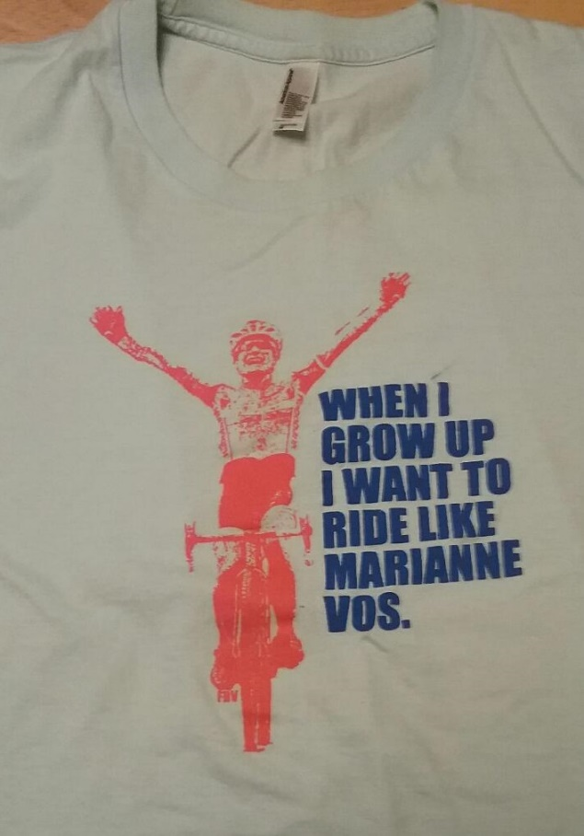
Is it a photographer’s exclusive right to alter his photo, put it on tee shirts, and sell them?
Marianne Vos wins over Kristen Wild and Emma Johansson by anMarton is licensed under CC BY NC ND.
Notes:
Is this fair use? See http://cdas.com/cairou-v-prince/

Slide 19
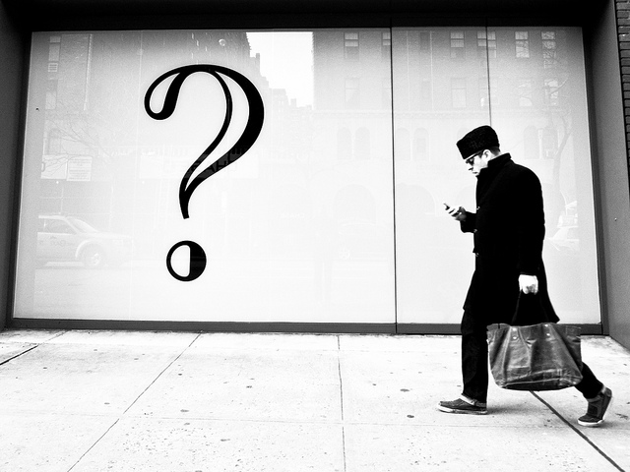
What if you want to use a work but you do not own its copyright?
More Questions Than Answers by Tom Waterhouse is licensed under CC BY NC.
Notes:
Here’s the big question.

Slide 20
What if you want to use a work but you do not own its copyright?
Get permission for the use
Be fair
Notes:
Here’s the big question.
-Permission – will be a license for use. Contractual agreement for use – often in exchange for a fee. Sports Illustrated photo example. Will have limits, such as designated uses, duration of permission, geographic boundaries, etc. We enter these agreements all the time, e.g. for software like the Microsoft Office suite, Netflix, Amazon Prime, Facebook.
-Be fair – expanding area of law

Slide 21
FAIR USE
Notes:
Big grey area.

Slide 22
17 USC §107 Limitations on exclusive rights: Fair use
[F]air use of a copyrighted work . . . for purposes such as criticism, comment, news reporting, teaching . . . scholarship, or research, is not an infringement of copyright. In determining . . . fair use the factors to be considered shall include—
(1) the purpose and character of the use, including whether such use is of a commercial nature or is for nonprofit educational purposes;
(2) the nature of the copyrighted work;
(3) the amount and substantiality of the portion used in relation to the copyrighted work as a whole; and
(4) the effect of the use upon the potential market for or value of the copyrighted work.
Notes:
Educational uses are examples of favored purposes of use. Purpose is one of four factors.

Slide 23
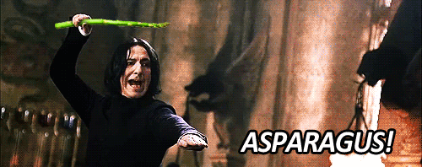
Substantiality Nature Amount Purpose Effect on market
Notes:
Just for fun. Memory device for 5 factors instead of 4.

Slide 24
Fair Use Trueisms
Fair use is deliberately flexible.
Each situation is different.
Nobody can say in advance whether a use is fair or not.
It requires thinking, so it’s fun.
Notes:
Educational use is not a guarantee that a use is fair.

Slide 25
Tools!
Fair use checklist?
Fair use evaluator?
You

Slide 26
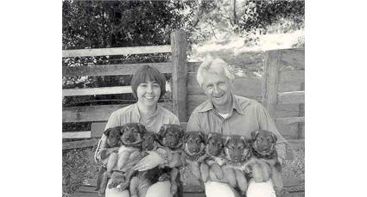
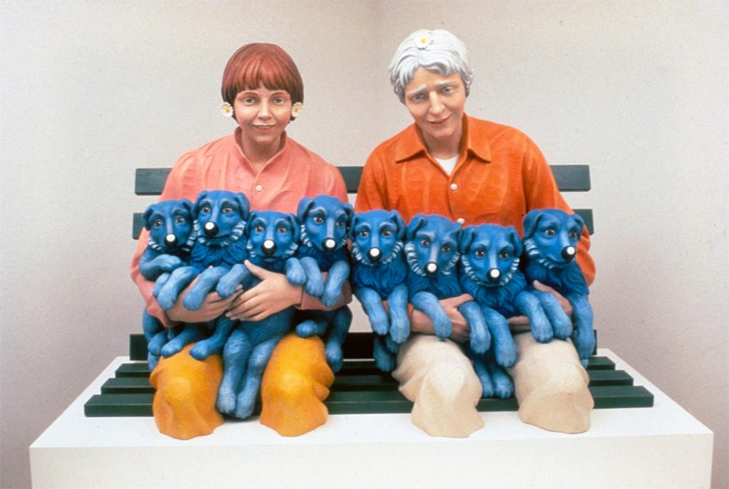
Rogers v. Koons
String of Puppies. Jeff Koons . 1988. In ARTstor [database online]. 9 December 2014. Available from ARTstor, Inc. New York, New York.
Notes:
EXAMPLE 1: Rogers v Koons (1992) Puppies
1. Hand out fair use checklists.
2. Assign a student to be scorekeeper for factors. How many for fair use? How many against?
Facts: Art Rogers earned his living by creating and licensing his photographs. His work was exhibited widely. In 1980, a couple asked him to photograph them with their 8 German shepherd puppies. Rogers arranged the lighting as well as the positions of the people and their dogs. Rogers sold a print of the photograph to the couple, then licensed it to commercial users including a greeting card company.
Jeff Koons bought a greeting card with Rogers’s image at a shop. He liked the image because he thought it tied into the “collective subconscious”. In other words, he thought it would seem familiar to viewers even if they hadn’t seen it before. Koons tore the credit information from the card. He then instructed a workshop in Italy to recreate the subjects of the photo in wood, stressing that the wooden sculptures be faithful to the photograph. The resulting sculpture was included in his exhibit, “The Banality Show”, at his gallery in New York. Rogers sued for copyright infringement.
Ask students to go through factors one-by-one and explain whether they feel Jeff Koons’s use is fair. Then compare students’ reasoning with the judges (below).
Purpose - Koons argued he used the photograph to comment on and satirize society at large. The court acknowledged that satire and parody are accepted forms of fair use, but thought that Koons’ work did not belong to this tradition.
Court’s definitions: “Parody or satire . . . is when one artist, for comic effect or social commentary, closely imitates the style of another artist and in so doing creates a new art work that makes ridiculous the style and expression of the original.”
“The rule's function is to insure that credit is given where credit is due. By requiring that the copied work be an object of the parody, we merely insist that the audience be aware that underlying the parody there is an original and separate expression, attributable to a different artist.“ Usually because the targeted work is well-known or because the artist acknowledges the targeted work.
But Koons didn’t make a parody of the original photo. Instead, he argued that by reproducing the photo he was satirizing society at large. But if this is allowed, everyone could copy works closely and argue they are satirizing larger themes (e.g. all of society). A parody must reference (not copy) an original work, and the audience must know that a separate work is being targeted. An artist must “give credit where credit is due.”
“[E]ven given that "String of Puppies" is a satirical critique of our materialistic society, it is difficult to discern any parody of the photograph "Puppies" itself. . . . Koons' copying of the photograph "Puppies" was done in bad faith, primarily for profit-making motives, and did not constitute a parody of the original work.”
The nature of the work was creative and artistic.
The amount of work used was greater than necessary for a parody.
Effect on the market - the court considered not only the market for the original but also the market for derivative works. Koons’s use reduced a potential market for other reproductions of Rogers’s work.
The judges wrote, “The copying was so deliberate as to suggest that defendants* resolved so long as they were significant players in the art business, and the copies they produced bettered the price of the copied work by a thousand to one, their piracy of a less well-known artist's work would escape being sullied by an accusation of plagiarism.”
*Koons’s gallery was a codefendant.

Slide 27
Campbell v. Acuff-Rose Music, Inc.
Pretty Woman Roy Orbison 1965
Pretty Woman 2 Live Crew 1989
Notes:
Campbell v. Acuff Rose Music US Supreme Court 1994
Acuff-Rose Music, Inc. held the rights to the popular song Oh, Pretty Woman, written by Roy Orbison and William Dees in 1964. 2 Live Crew wrote and recorded a parody of the song in 1989. They told Acuff-Rose about their parody and offered to pay a license fee and list all credits for the song to Acuff-Rose, Orbison, and Dees. Acuff-Rose refused permission. Nevertheless, 2 Live Crew included the song in its next release, providing credits to the authors of Oh, Pretty Woman. Acuff-Rose sued for infringement, and the case was appealed all the way to the Supreme Court. Here is the Supreme Court’s fair use analysis:
Purpose of the use was to parody. Parodies must reference their target in some way that the source is recognizable, and this use filled that requirement.
Quote: “The threshold question when fair use is raised in defense of parody is whether a parodic character may reasonably be perceived. Whether, going beyond that, parody is in good taste or bad does not and should not matter to fair use. . . . While we might not assign a high rank to the parodic element here, we think it fair to say that 2 Live Crew's song reasonably could be perceived as commenting on the original or criticizing it, to some degree. 2 Live Crew juxtaposes the romantic musings of a man whose fantasy comes true, with degrading taunts, a bawdy demand for sex, and a sigh of relief from paternal responsibility. The later words can be taken as a comment on the naiveté of the original of an earlier day, as a rejection of its sentiment that ignores the ugliness of street life and the debasement that it signifies.”
Nature of the original was highly creative, yet “parodies almost invariably copy publicly known, expressive works.”
The amount of the original used was no more than necessary to produce a parody. Quote: “[T]he parody must be able to "conjure up" at least enough of that original to make the object of its critical wit recognizable.”
Quote about the heart of the work:
“But if quotation of the opening riff and the first line . . . go to the "heart" of the original, the heart is also what most readily conjures up the song for parody, and it is the heart at which parody takes aim. Copying does not become excessive in relation to parodic purpose merely because the portion taken was the original's heart. If 2 Live Crew had copied a significantly less memorable part of the original, it is difficult to see how its parodic character would have come through. . . . It is significant that 2 Live Crew not only copied the first line of the original, but thereafter departed markedly from the Orbison lyrics for its own ends.”
The parody likely had no effect on the market for the original “because the parody and the original usually serve different market functions.” Moreover, parody does no damage to derivative markets because such markets include only uses that creators would make or license.

Slide 28
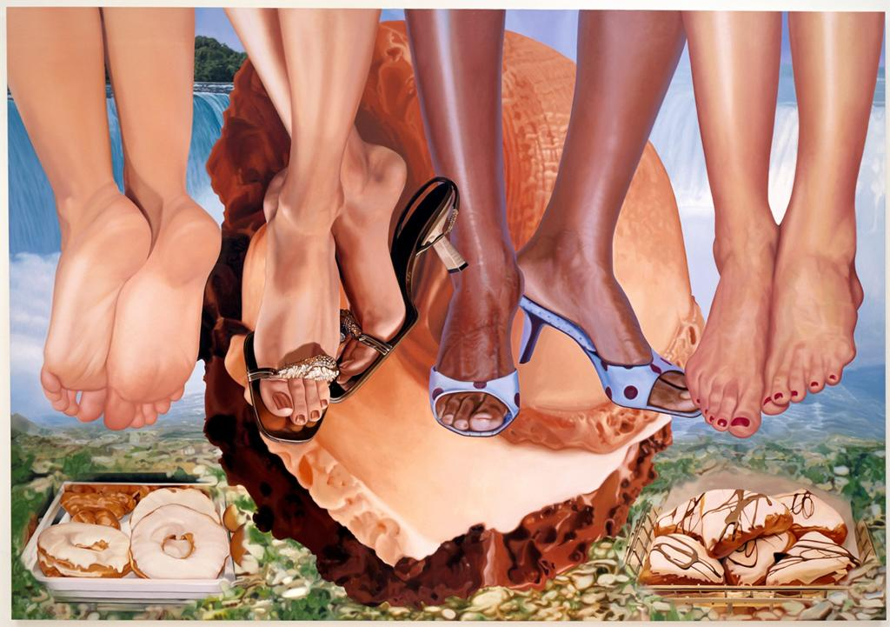
Blanch v. Koons
Niagara. Jeff Koons. 2000. In ARTstor [database online]. 9 December 2014. Available from ARTstor, Inc.
New York, New York.
Notes:
Blanch v. Koons (2006)
Photographer Andrea Blanch saw this painting by Jeff Koons on display and recognized two legs and feet from a fashion photo shoot she had done for Condé Naste Publications. She had not licensed her work to Koons or any other artists. She sued Koons for copyright infringement.
The court’s fair use analysis:
• Koon’s purpose was transformative in 2 ways.
1) The original was a picture in a magazine photo while Koons’ work was painting.
2) Koons used the work with a different purpose than Blanch did; he juxtaposed images from popular culture so that “the viewer [would] think about his/her personal experience with these objects, products, and images and at the same time gain new insight into how these affect our lives.” Koons used the photo to comment on ubiquitous fashion photographs.
The public benefit in making art is greater than the commercial nature of this use.
Koons did not gain from rote reproduction; he transformed the image into something new.
• Nature of the work was creative, which weighed against fair use.
• Amount and substantiality of the portion used were reasonable in light of Koon’s purpose.
• No market effect on Blanch’s work because she did not license her photographs or use them after they were published, and she had no plans to do so with the photo in question. Koons’s use of her work did not affect her career plans.

Slide 29
What is a license?
A contractual agreement for permission to use a work
Often in exchange for a fee
Could be limited by user group, geography, time, number of uses, or types of uses
Notes:
When you acquire a license, you’ll have permission to exercise rights that are normally reserved for the © holder. Often your rights will be limited by duration and other factors. Expect to be charged a fee for your uses.

Slide 30
Summary
• Copyright is broad and exclusive.
• Use only enough of a work necessary to conjure the original.
• Transform work by
using it to create something new or
using it in a new way that the copyright owner would not.
Be clear that your work comments on the original and does not substitute for it.
Choose your targets carefully. Beware of Walt Disney Corp.
Best practices explain community norms.
Understand options and consequences if infringement is alleged
Notes:
No best practices expressly for remix/parody, but ‘Code of Best Practices in Fair Use for Online Video (http://archive.cmsimpact.org/sites/default/files/online_best_practices_in_fair_use.pdf) contains a useful discuss of fair use and its limits for ‘recombinant’ video works.
What might happen if a copyright owner thinks you have infringed their work (reminder – this is not legal advice!):
You receive notification from an online platform (YouTube, SoundCloud, GitHub, etc.) that they’ve received a ‘takedown notice’ for your content:
DMCA allows online platforms to avoid liability by disabling content someone has claimed is infringing – they will disable access to your content and notify you of the change
You have not been sued nor has the content owner personally identified you – they are (for now) merely seeking to have the content removed, but can use the notice as a basis for identifying and suing you in future
You can file a ‘counter notice’ if you believe your content is non-infringing to have it reinstated – be very careful when taking this step, as you are swearing under penalty of perjury that you believe that the takedown notice is mistaken (i.e. that you had a right to use the material) and identifying yourself to the copyright owner
You receive a ‘cease & desist’ letter or a letter asking you to pay a license fee:
The copyright owner is asking you to stop using their work and/or to pay them for using it, and may threaten to sue if you don’t
Obtain legal advice - don’t respond before doing so, as what you say or do could be used against you
You receive a ‘summons’ or other notice from a court:
Definitely obtain legal advice!
If you need legal advice, consider starting with a free consultation at UW’s Student Legal Services

Slide 31
Thank you!

